Slide 1


Stock Market Prediction
Ning Chen

Slide 2
Agenda
Overview
Business Understanding
Exploratory Data Analysis
Frontend
1
3
5
2
4
6
Data Collection
Classification
Time Series
Sentimental Analysis
Next Steps

Slide 3
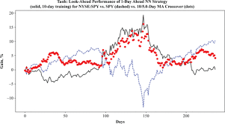
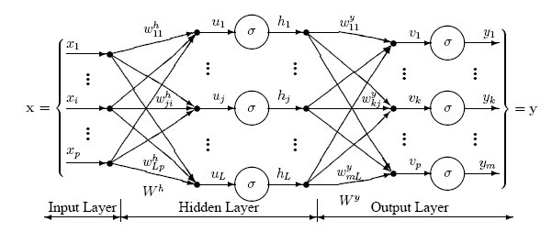
Overview
Accurate prediction of stock market asset is a significant and challenging task due to complicated nature of the financial stock markets.

Slide 4

Business Goals
Stock market prediction aims to determine the future movement of the stock value of a financial exchange.
Classification: Trade Strategy (buy sell hold)
random forest, SVM, Xgboost, NN
time series regression model: SARIMAX, Facebook Prophet, LSTM
sentimental analysis: NLP

Slide 5


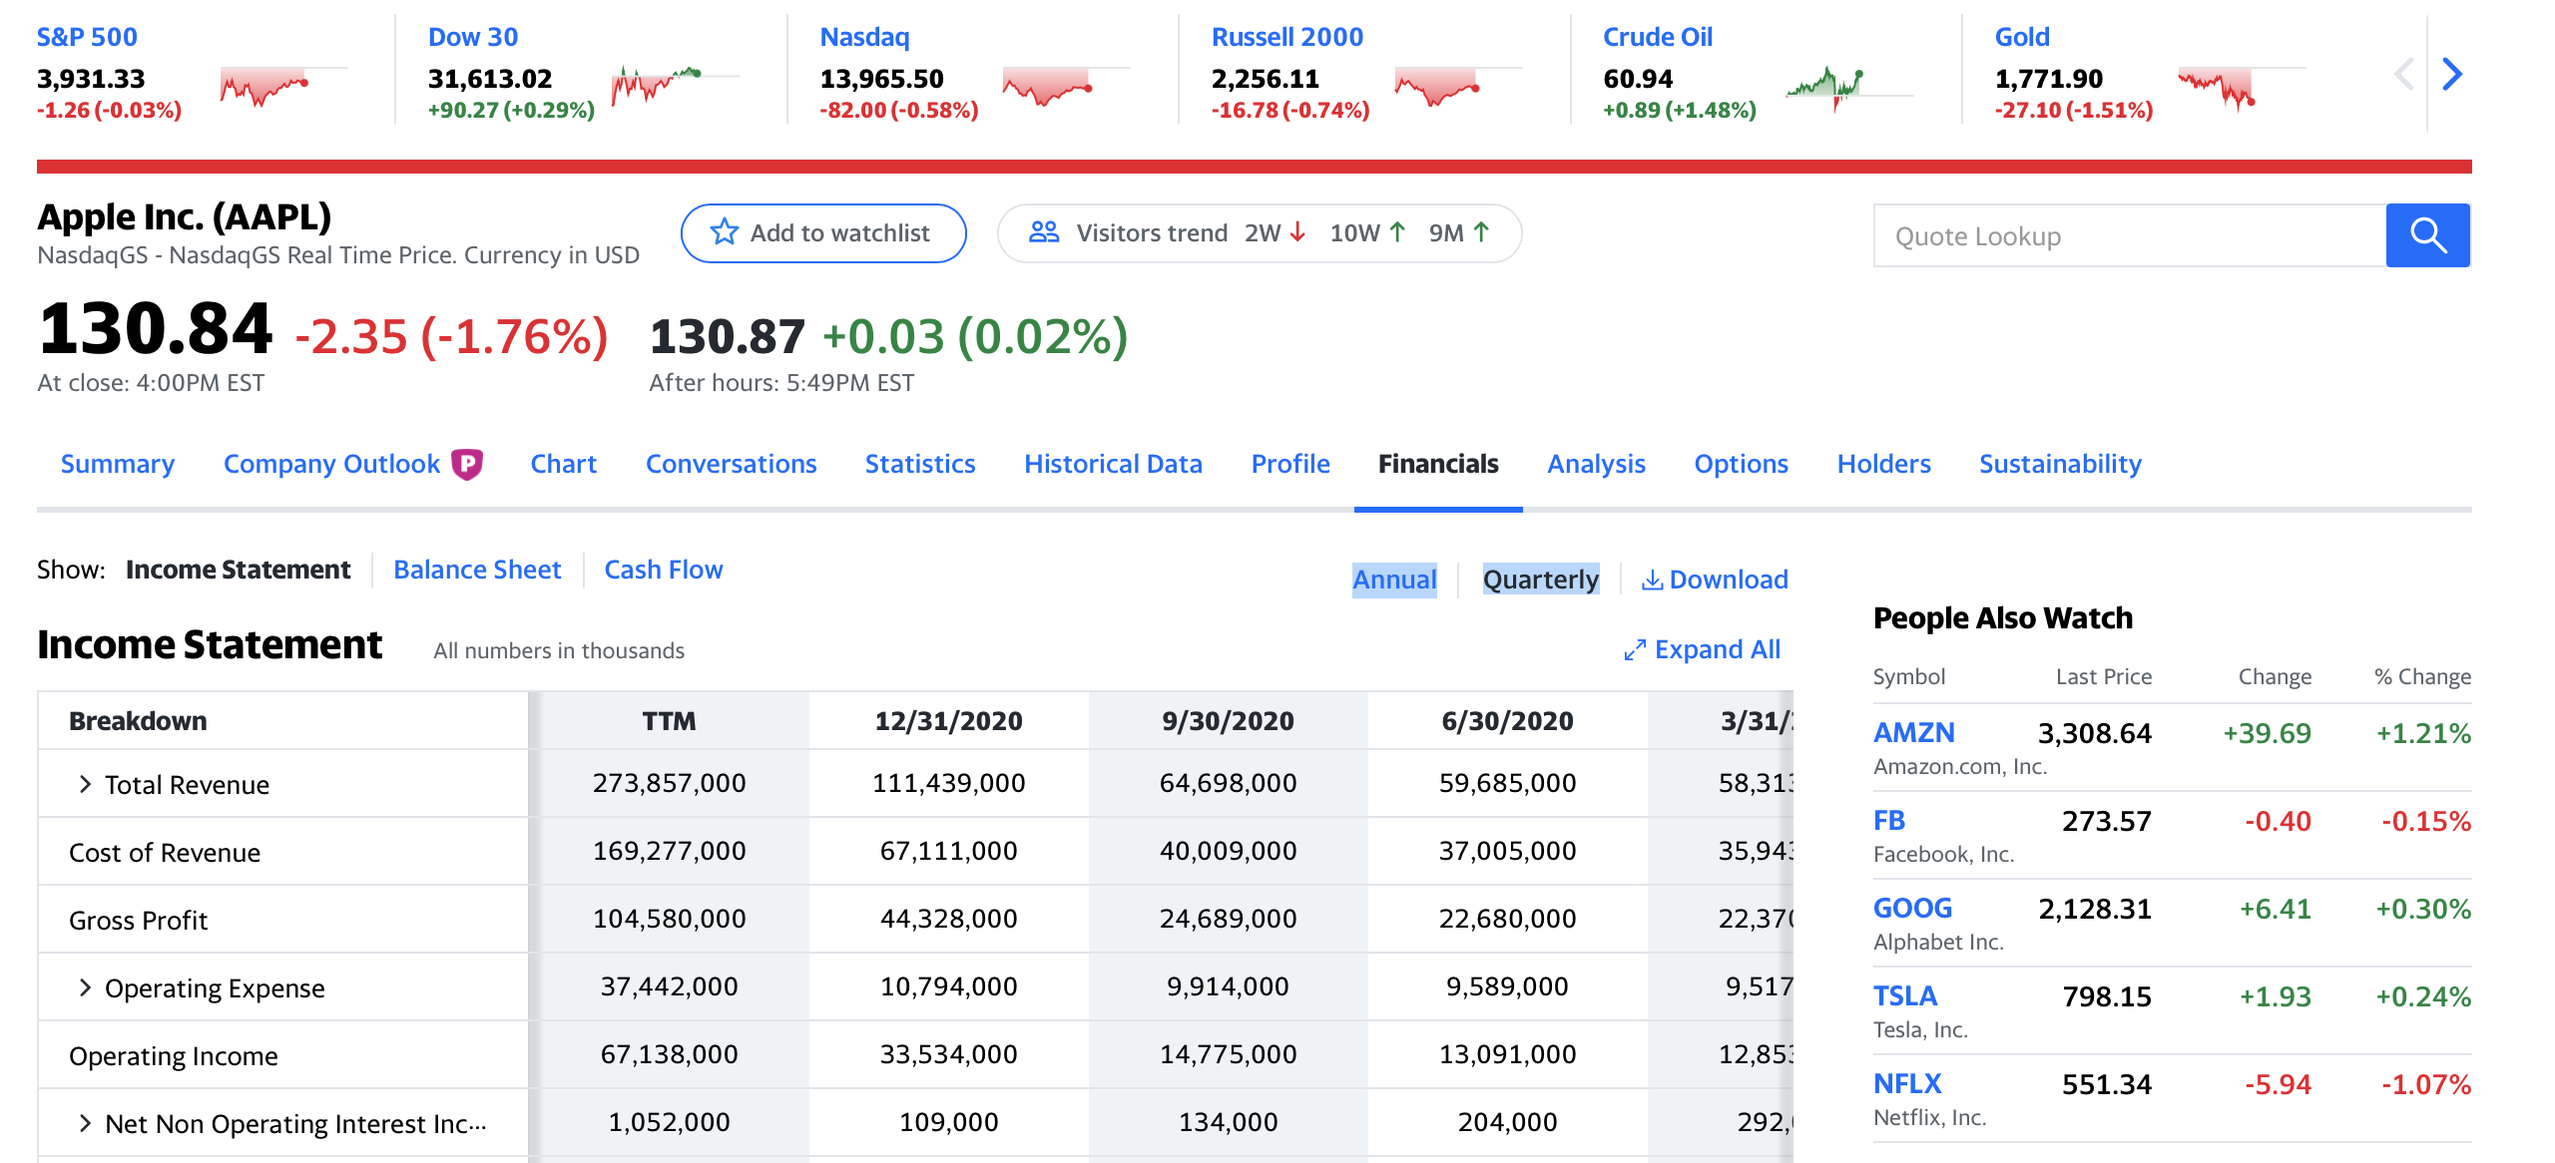
Data Collection
Data was collected from three different web sources by API calls or Web Scraping.
-Quarterly Report for Classification by Web Scrapping.
-Yahoo Finance and IEX API for Time Series by API calls.
-Twitter for sentimental data by VADER.

Slide 6
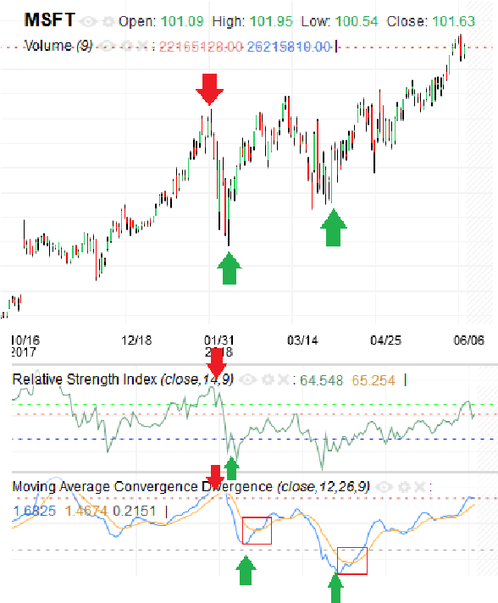
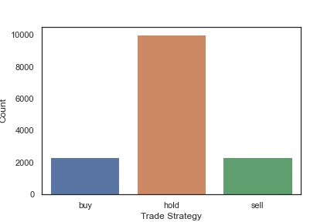
Exploratory Data Analysis
Trade Strategy
local minimum of the price to buy, local maximum of the price to sell, and all other time to hold.
sell
buy
buy

Slide 7
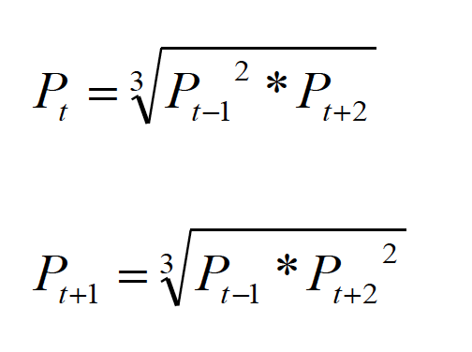
Exploratory Data Analysis
Missing data
The missing data for weekends and holidays was filled by interpolation method.
The missing data of exogenous features was filled by propagating nearest valid observation backward/forward to next valid observation.
The fact that data are missing should not be neglected—quite often it is an indication of illiquidity. Using an average price results in an underestimate of volatility.

Slide 8
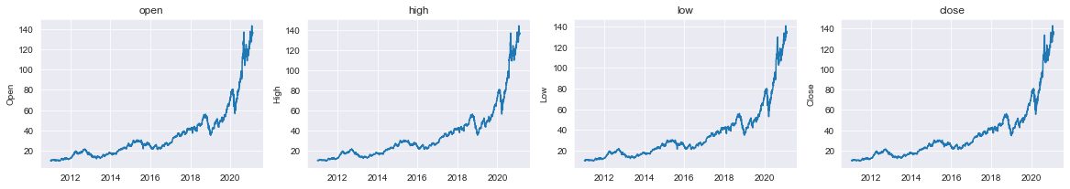
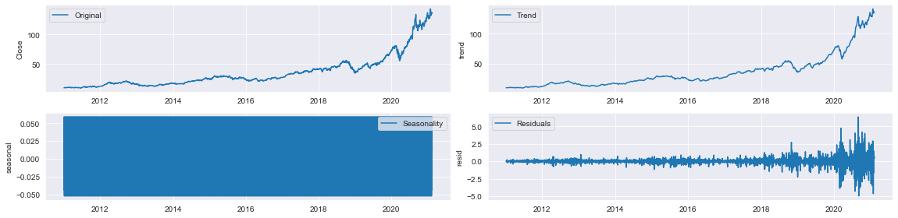
Exploratory Data Analysis
stock price
seasonal decompose

Slide 9
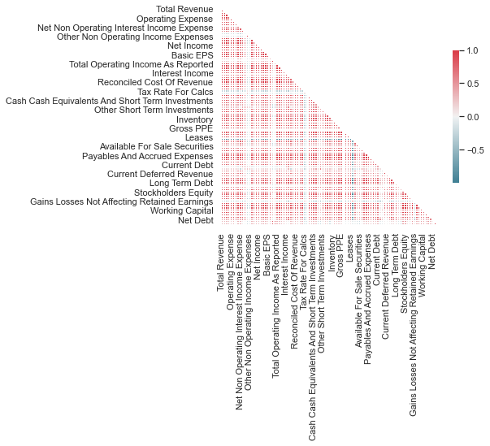
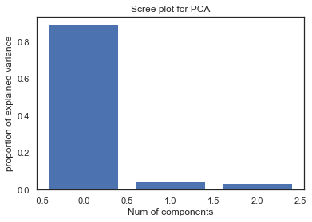
Classification
Correlation
Principle Component Analysis (PCA)

Slide 10
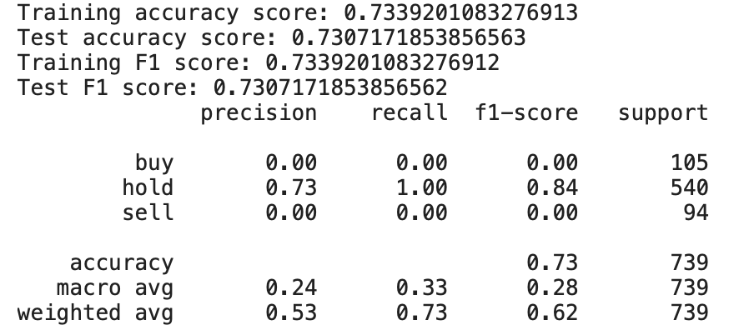
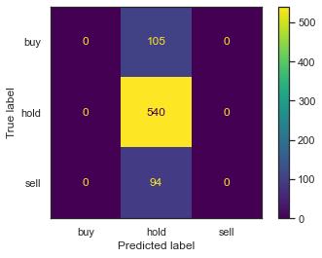
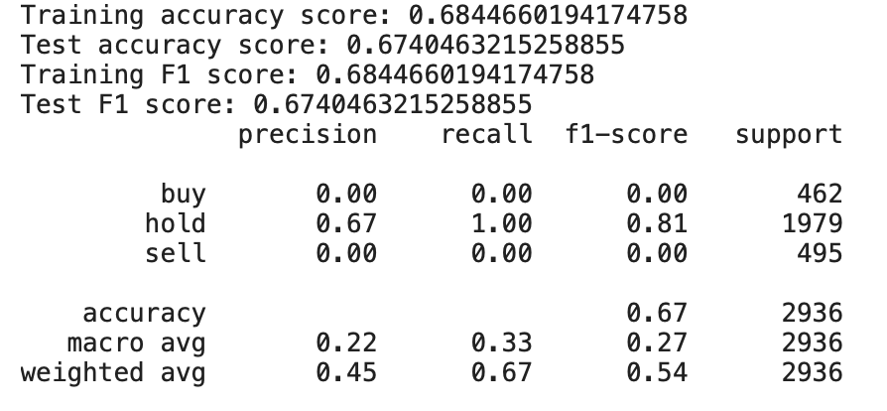
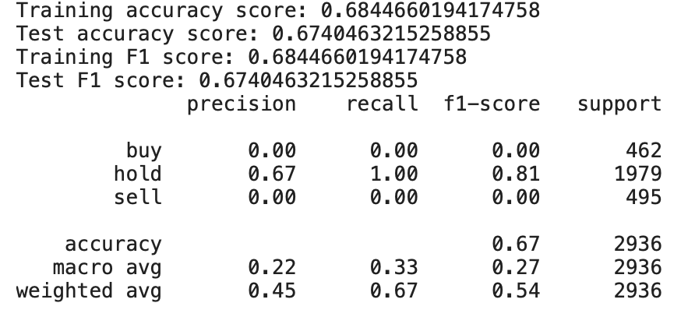
Classification
Gridsearch with classification algorithms
SVM
random forest
Xgboost

Slide 11
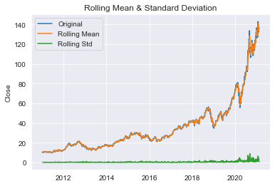
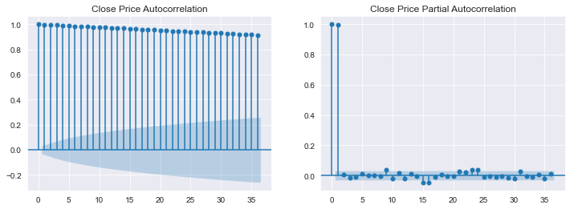
Time Series
Dickey-Fuller Test
ACF & PACF

Slide 12
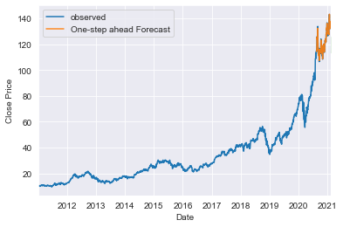
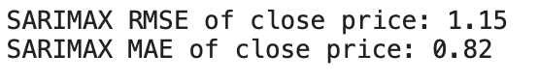
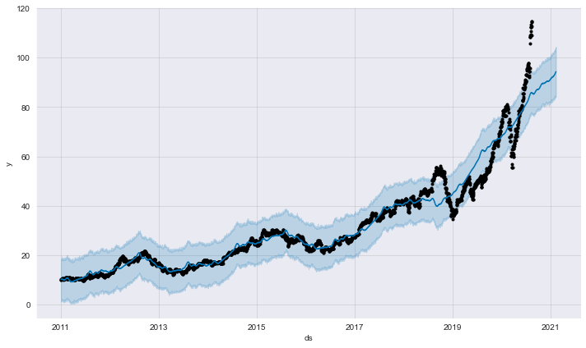
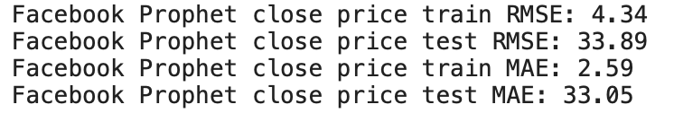
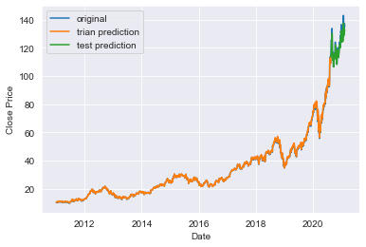
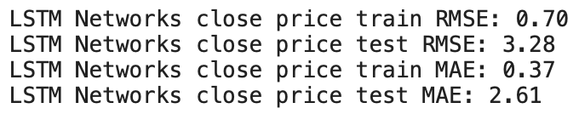
Time Series
SARIMAX Model
with
exogenous features
Facebook Prophet
LSTM

Slide 13
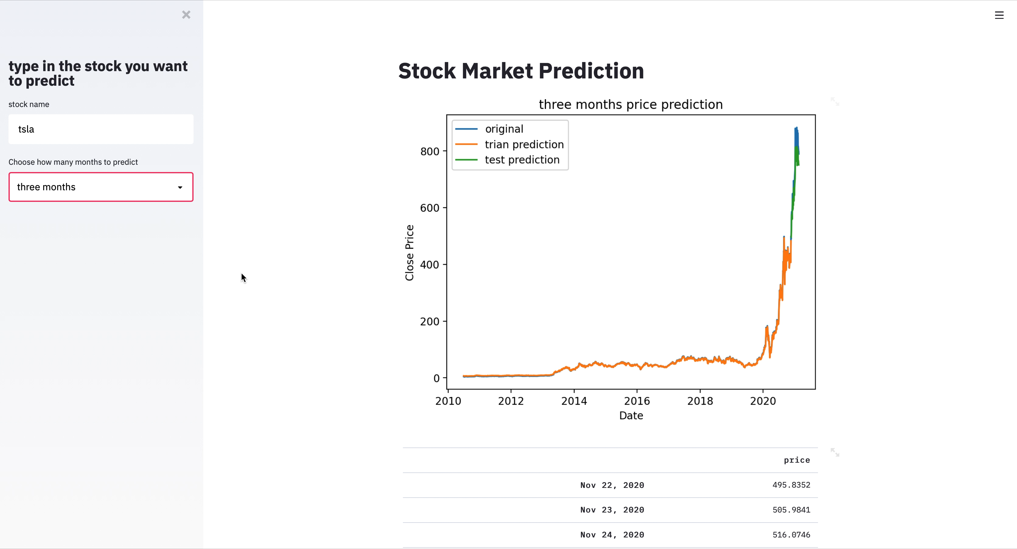
Frontend
Streamlit was used to create a frontend to predict stock price with different time range.

Slide 14

Next Step
-To access the updated quarterly reports timely and obtain more important features.
-To tune the hyperparameters (exogenous variables) in Time Series models. Technical indicators such as MACD, Stochastic, RSI, etc can be used.
-Besides Twitter, gathering more relevant sentimental data from other web sources.

Slide 15

Thank you
GitHub: https://github.com/ghcn345/Stock-Market-Prediction
streamlit: http://192.168.1.99:8501
Blog: https://kinder-chen.medium.com
LinkedIn: https://www.linkedin.com/in/ning-chen-bb1851145/

